Slide 1
Linear Regression
Submitted by:
Nithin Thomas

Slide 2

Content of Presentation
Description of the Analysis
Hypothesis Statements
R Script used for the analysis
Key Insights
Two Variables to Increase Accuracy
Reference

Slide 3
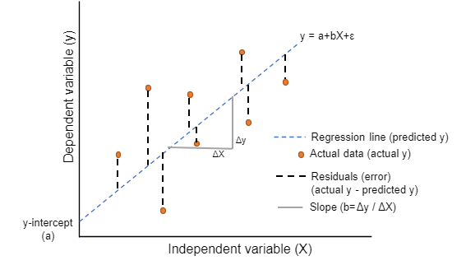
Description of the Analysis
This analysis is carried using Linear Regression to predict the value of an outcome of dependent variable Y using one or more independent predictor variables X
y = a + bX + ϵ
This method calculates the best-fitting line for the observed data by minimizing the sum of the squares of the vertical deviations from each data point to the line.
To view the fit of the model to the observed data, one may plot the computed regression line over the actual data points to evaluate the results.
a is the intercept & b is the slope and are called regression coefficients.
ϵ is the error term, the part of Y the regression model is unable to explain.
y is dependent variable
X is independent variable
Figure 1.1 Linear Regression

Slide 4
Hypothesis Statements
Null Hypotheses, H₀: β=0, co-efficient β of the predictor is zero and not statistically significant. i.e., A relationship between dividend(independent) and stock_return_scaled(dependent) doesn’t exist.
Alternative Hypotheses, H₁: β ≠0, co-efficient β of the predictor is not equal to zero and is statistically significant. i.e., A relationship between dividend(independent) and stock_return_scaled(dependent) does exist.

Slide 5

R Script Used for the Analysis
Step 1:
#Load Libraries
library(dplyr)
library(ggplot2)
Step 2:
Load dataset into R
loadhistory("~/DC Data Analytics/1204 Statistical Prep Modeling by Ritwick Dutta (RD)/Assignment5/ols_stock.xlsx")
Step 3:
#Correlation
cor(ols_stock$dividend, ols_stock$stock_return_scaled)
Output

Slide 6
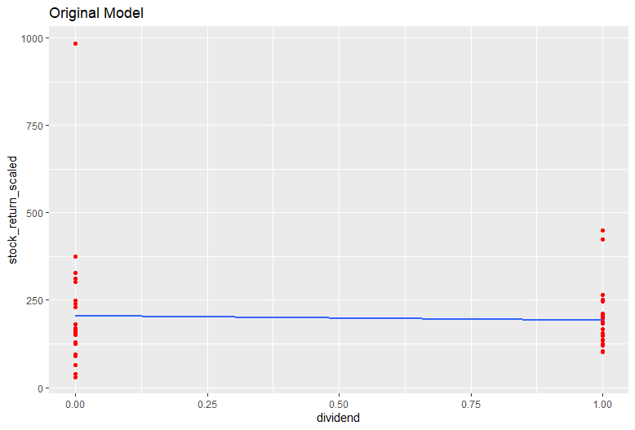
R Script Used for the Analysis
Step: 4
#ggplot
ggplot(ols_stock, aes(x = ols_stock$dividend, y = ols_stock$stock_return_scaled))+ geom_point(colour = "red") + geom_smooth(method = "lm", fill = NA) + labs(title = "Original Model",x = "dividend",y = "stock_return_scaled")
Output

Slide 7
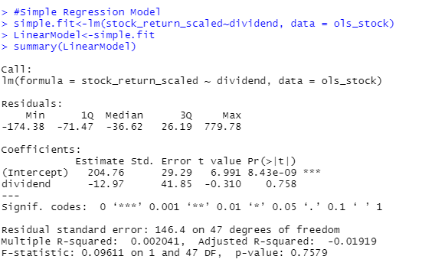
R Script Used for the Analysis
Step: 5
#Simple Regression Model
simple.fit<-lm(stock_return_scaled~dividend, data = ols_stock)
LinearModel<-simple.fit
summary(LinearModel)
Output

Slide 8
Key Insights
From the output in step 5, Multiple R-Squared value is 0.00204 or 0.2%. It indicates that the model fails to explains the variability of the response data around its mean.
From the output in Step 5, p-value is 0.7579 which is greater than 0.05 significance level, hence we accept the null hypothesis(H₀) and reject the alternative hypothesis(H₁) which implies that there is no significant relation between dividend(independent) and stock_return_scaled(dependent).
From the output in step 5, max value of 779.78 indicated that there is a point which lies far above from the predicted regression line and min value of -174.38 indicated that there is a point lies far below the predicted regression line.

Slide 9
Key Insights
From the output in step 5, Equation for Regression Model is Y(stock_return_scaled) = 204.76 -12.97 * X(dividend) + error.
So, if the company provides dividend(i.e. X=1) then according to our predicted model, stock_return_scaled value = 191.79(204.76 -12.97 * 1+ error)
if the company doesn’t provide dividend(i.e., X= 0) then stock_return_scaled value = 204.76(204.76 -12.97 * 0+ error).
This indicates that since our independent variable is categorical we will have only two outcomes for the predicted value of Y.

Slide 10
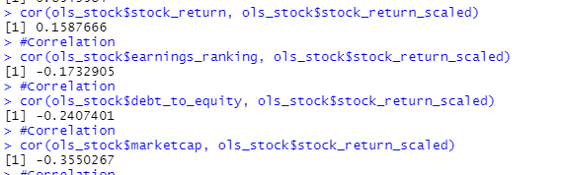
Two Variables to Increase Accuracy
In order to identify 2 other variables which have impact on dependent variable a correlation analysis is conducted:-
Figure 1.2 Correlation Output
From the above results, it is found that debt_to_equity & marketcap is having higher correlations so I would suggest to add those variables to obtain a better regression model.

Slide 11
Reference
Week12-Data1204 Slides from DC connect -> Course content

Slide 12


